Slide 1
PROJECT ON
STEGANOGRAPHY USING AUDIO
IN RMON SYSTEM
BY:
SARTHAK GOEL
349/CO/15

Slide 2
INTRODUCTION
In a computer-based audio Steganography system, secret messages are embedded in digital sound. The secret message is embedded by slightly altering the binary sequence of a sound file. Existing audio Steganography software can embed messages in WAV, AU, and even MP3 sound files. Embedding secret messages in digital sound is usually a more difficult process than embedding messages in other media, such as digital images.

Slide 3
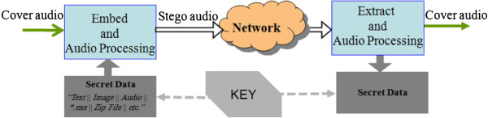
GOALS AND OBJECTIVES
The goal of steganography is to avoid drawing suspicion to the existence of a hidden message. This approach of information hiding technique has recently become important in a number of application areas.
The main objective of the project “Audio steganography” is to embed the text message in cover audio file, using the available methods of audio steganography methods. The receiver extracts the message from carrier audio file.

Slide 4
WHAT IS RMON(REMOTE MONITORING)
Remote Monitoring (RMON) is a standard monitoring specification that enables various network monitors and console systems to exchange network-monitoring data. RMON provides network administrators with more freedom in selecting network-monitoring probes and consoles with features that meet their particular networking needs
RMON(REMOTE MONITORING) is designed for "flow-based" monitoring

Slide 5
STEGANOGRAPHY USING AUDIO
In a computer-based audio Steganography system, secret messages are embedded in digital sound. The secret message is embedded by slightly altering the binary sequence of a sound file. Existing audio Steganography software can embed messages in WAV, AU, and even MP3 sound files.
Embedding secret messages in digital sound is usually a more difficult process than embedding messages in other media, such as digital images. These methods range from rather simple algorithms that insert information in the form of signal noise to more powerful methods that exploit sophisticated signal processing techniques to hide information.
Thus the main purpose of this report is to explain Audio Steganography and algorithm commonly employed for Audio Steganography and its applications

Slide 6
FUTURE SCOPE OF THIS PROJECT
The RMON(REMOTE MONITORING) can be used in schools, offices, internet cafe’s, organization’s etc. as a step towards security implementation’s. The server part can thereby closely monitor the clients using organization’s database and check unauthorized access to data.

Slide 7
SYSTEM SPECIFICATIONS
Hardware Specification
Processor : Intel P-III based system
Processor Speed : 250 MHz to 833MHz
RAM : 64MB to 256MB
Hard Disk : 2GB to 30GB
Software Specification:
Language : JDK 1.5, Net beans 6.9,Java
Operating System : Any Operating System.

Slide 8
Software Specification
Operating System :Windows2000/xp/windows8
Languages : java 2(EJB2.0, JDBC, JSP, Servlet, Java Mail)
Front End : HTML, JavaScript
Platform : J2EE
Web Servers : Web Logic8.1/Apache Tomcat 8.0
Backend : My SQL
Browser Program : Internet explorer/CHROME

Slide 9
MODULAR DESCRIPTION
Encryption
Encryption includes a message or a file encrypting. Encryption involves converting the message to be hidden into a cipher text. Encryption can be done by passing a secret key.Secret key can be used for encryption of the message to be hidden.It provides security by converting it into a cipher text,which will be difficult for hackers to decrypt. Moreover if the message is password protected,then while retrieving message,the retriever has to enter the correct password for viewing the message.
Hide Message
Hiding message is the most important module of steganography.It involves embedding the message into the cover text. Each pixel typically has three numbers associated with it, one each for red, green, and blue intensities, and these values often range from 0-255.In order to hide the message,data is first converted into byte format and stored in a byte array.

Slide 10
The message is then encrypted and then embed each bits into the LSB position of each pixel position. The least significant (rightmost) bit of each 8-bit byte has been co-opted to hide a text message.
Retrieve Message
It involves retrieving the embed message from the file independent of the file format. Once the message has been retrieved it has to be converted into original message or file.
This can be done by reading the embedded data from the master file. The read data will be in the bytes format. This message has to be converted into the suitable output file format.
Decryption
Decryption includes a message or a file decrypting. Decryption involves converting the cipher text into decrypted format. Decryption can be done by passing a secret key. Secret key can be used for decryption of the message that is hidden. It provides security by converting the cipher text, into the original data message or file .

Slide 11
Moreover if the message is password protected, then while retrieving message, the retriever has to enter the correct password for viewing the message.

Slide 12
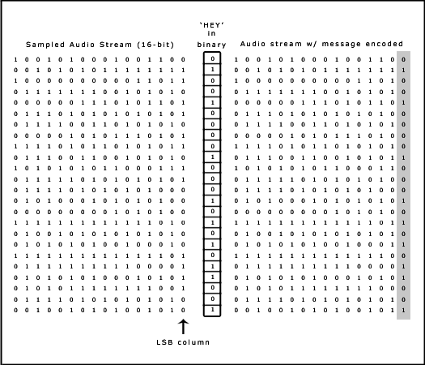
ALGORITHM USED
LSB CODING
Least significant bit (LSB) coding is the simplest way to embed information in a digital audio file. By substituting the least significant bit of each sampling point with a binary message, LSB coding allows for a large amount of data to be encoded. The following diagram illustrates how the message 'HEY' is encoded in a 16-bit CD quality sample using the LSB method:

Slide 13
In this algo of whatever size the file is it is divided into 16-bit each. As bits are organized vertically data to be hidden is entered into the last 16 bits of the file so it becomes very difficult for the intruder to get access to data .now after hiding our data in the audio file.
It plays in horizontal direction i.e streaming is done..so its very difficult to find data during streaming of data. As bits will not correspond to correct data.

Slide 14
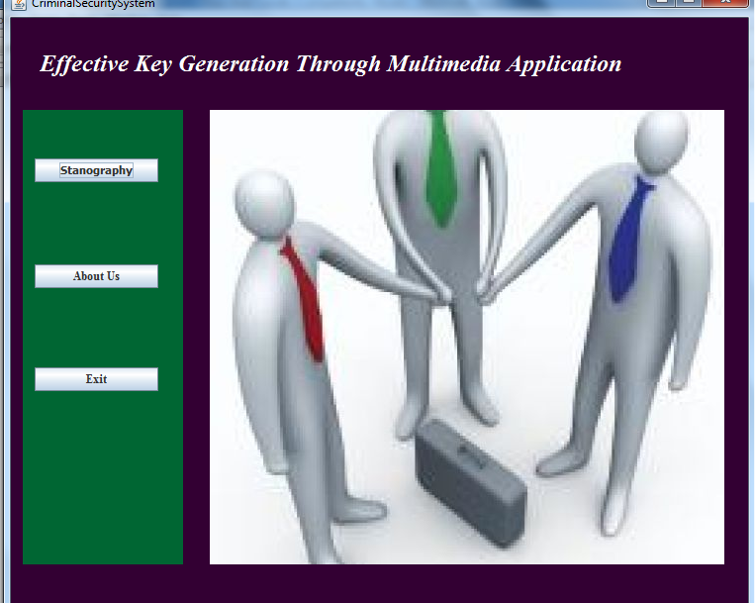
SNAPSHOTS

Slide 15
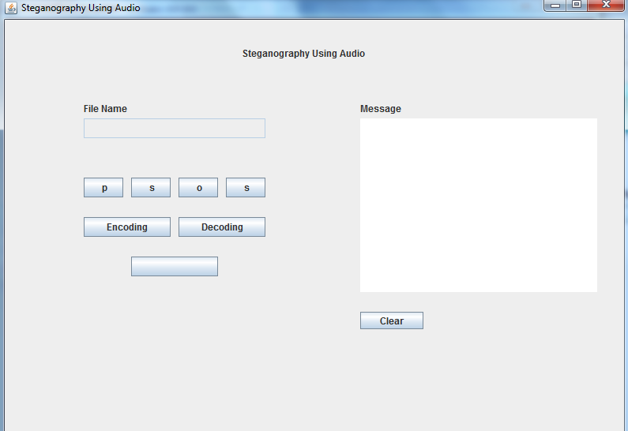

Slide 16
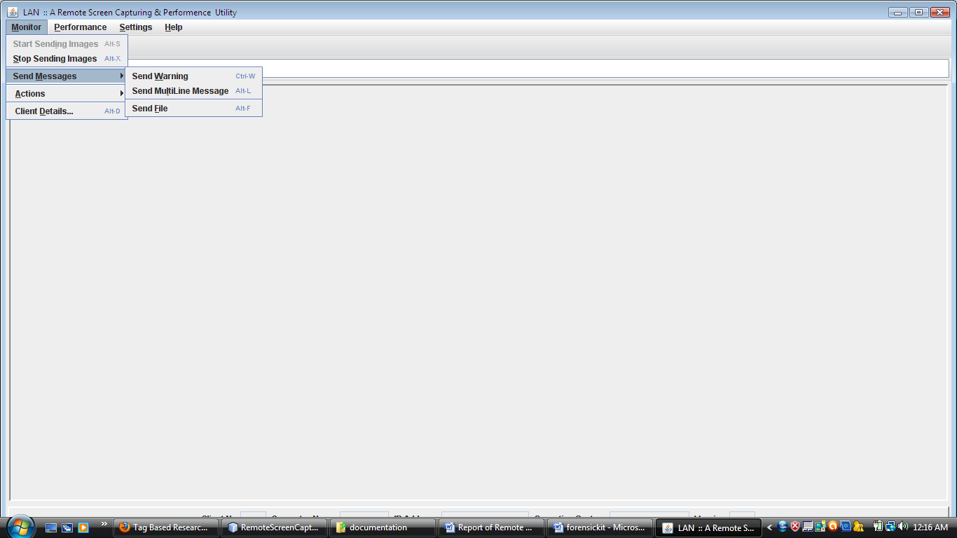

Slide 17
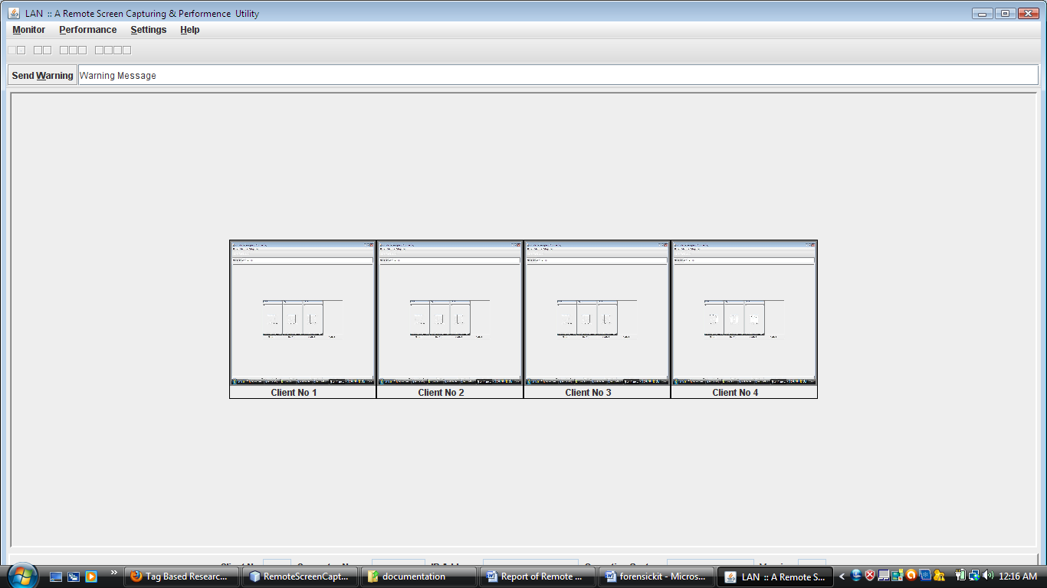

Slide 18
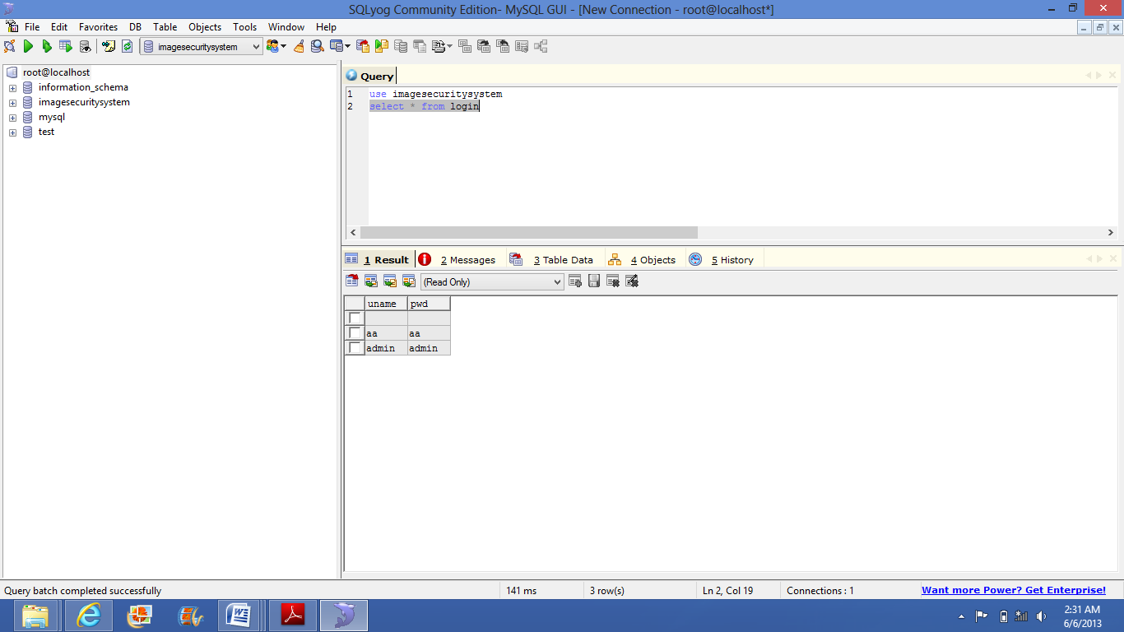
Database Snapshots

Slide 19
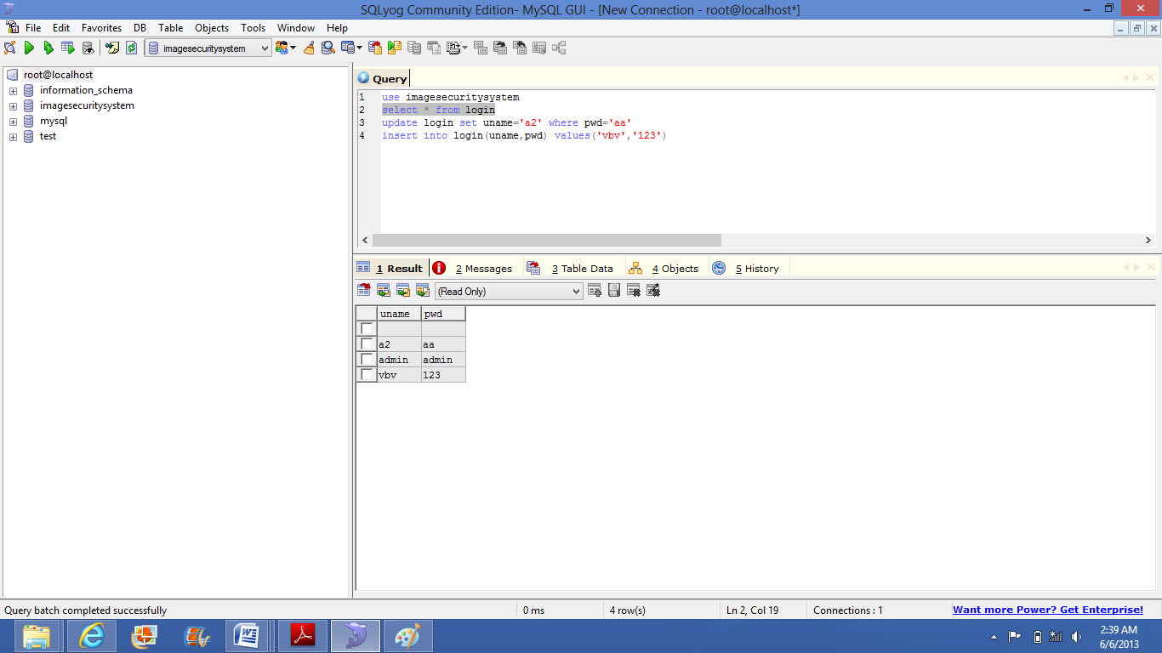

Slide 20
ADVANTAGE OF STEGANOGRAPHY OVER CRYPTOGRAPHY
The advantage of steganography over cryptography alone is that messages do not attract attention to themselves, to messengers, or to recipients.
Cryptography includes several secure algorithms for encrypting and decrypting messages. They are all based on the use of secrets called keys.
A cryptographic key is a parameter used in an encryption algorithm in such a way that the encryption cannot be reversed without the knowledge of the key.

Slide 21
ENHANCEMENTS
Video recording’s of the client’s window for non-repudiation.
Used for troubleshoot any upcoming problem.
Intrusion detection system can be implemented and penalty can be charged.
Used to find statistics of host.
To hold conversation between two different IP address.
In future, we can have the integrate the video recording system facility for the clients and client search engine that can provide the result on the basis of different criteria to search. We can also have one more module of implementing this project on this application

